Slide 1
THANK YOU !!! TO All our wonderful sponsors of our 5 year anniversary Wow Gal Celebration

Slide 2
Our
Platinum
Sponsor

Slide 3
Our 1st Gold Sponsor

Slide 4
Our 2nd Gold Sponsor

Slide 5
Our Silver Sponsor

Slide 6
Our
Bronze
Sponsor

Slide 7
She Is Amazing
Sponsors

Slide 8
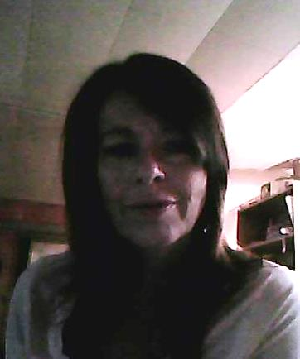
She Is Amazing
Sponsors cont’d
She Is Amazing Recipients
Janet Howell
Nancy Devitt

Slide 9
Our WOW Entertainer

Slide 10
WOW Gals Giving Complementary Sessions

Slide 11
Our Booklet Advertisers…

Slide 12
Booklet Advertisers Cont’d

Slide 13
Booklet Advertisers Cont’d

Slide 14
Booklet Advertisers Cont’d

Slide 15
Booklet Advertisers Cont’d

Slide 16
Booklet Advertisers Cont’d

Slide 17
Booklet Advertisers Cont’d

Slide 18
Silent Auction Contributors

Slide 19
Silent Auction Contributors Cont’d

Slide 20
Silent Auction Contributors Cont’d

Slide 21
Goodie Bag Contributors

